Slide 1

THIRD EYE
TEAM NO:4
TEAM MEMBERS: AKHIL SANKAR S
ALPHY GEORGE
IRENE MOLLY VARUGHESE
RINTA MARIA RAJU
GUIDED BY: PROF. THUSHARA SUKUMAR
ASSISTANT PROFESSOR
DEPT OF CSE

Slide 2
CONTENTS
Introduction
Timeline
Areas of growth
Summary
Primary goals
Presentation Title

Slide 3

PROBLEM STATEMENT
There are millions of visually impaired people worldwide who struggle with everyday tasks. Visually impaired individuals face significant challenges when it comes to navigating their surroundings independently and safely.
The absence of visual cues often leads to obstacles and hazards that can hinder their mobility and reduce their quality of life.
We aim to enhance the mobility and independence of visually impaired individuals by developing a wearable device that can be attached to their spectacles.

Slide 4


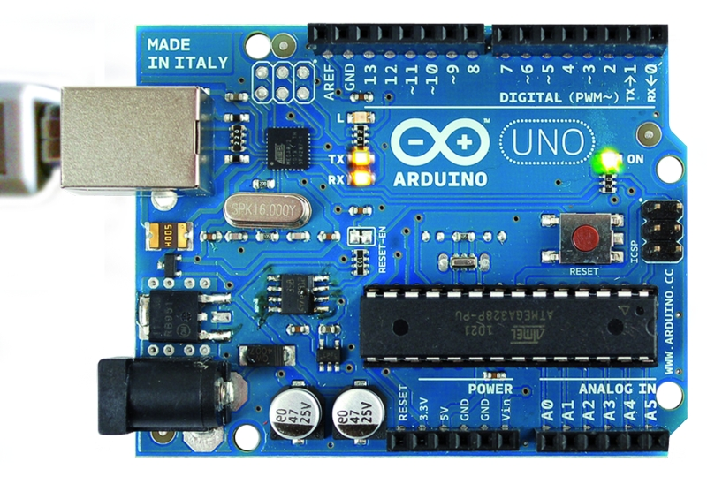
TECHNOLOGY STACK
A Powerful and versatile programming language that is perfect for processing and analyzing large datasets.
An open-source computer vision library that provides an extensive set of tools for analyzing visual data
Arduino:A powerful microcontroller board that is used to create interactive electronic devices.

Slide 5
REQUIREMENTS
Object Detection
Navigation
Text to Speech
Distance measurement: using depth sensor
Real time auditory feedback

Slide 6
OBJECT DETECTION
What is Object Detection?
Object detection is a technique used in computer vision that allows machines to identify and locate objects in digital images or videos.
Goal of Object Detection
The main goal is to determine the location and size of one or more objects in an image or video, and assign a class label (what the object is) to those objects.
Steps Involved in Object Detection
Image Classification: This step involves determining what objects are present in the image.
Object Localization: This step involves determining where exactly in the image these objects are located.
Use of Object Detection
It’s fundamental to many computer vision tasks such as object classification, counting of objects, and object monitoring.
It’s also used in developing self-driving systems to detect and localize other vehicles, pedestrians, and obstacles on the road.

Slide 7
How does object detection work?
Object detection combines image classification and object localization techniques to analyze and categorize objects within an image or video. The basic process of object detection includes the following steps:
Inputting an image or multiple images into an object detection algorithm
The algorithm analyzes the provided image(s)
The algorithm applies a bounding box around each object to identify the location and assigns a class label to that object using image classification.
The previous step informs the algorithm where and what the object of the image is.
The algorithm then outputs the location, size, and class label for each object in the image.

Slide 8
Algorithm
There are several different object detection algorithms, including R-CNN, Fast R-CNN, YOLO, and Single Shot MultiBox Detector (SSD). These algorithms use a variety of techniques, including CNNs, Region-based fully convolutional networks, etc., to accurately identify and locate objects within an image.

Slide 9
YOLO-You Only Look Once
What is YOLO?
YOLO is a state-of-the-art, real-time object detection algorithm introduced in 2015.
The term ‘You Only Look Once’ signifies that the algorithm processes an image in one pass1.
How does YOLO work?
YOLO frames the object detection problem as a regression problem.It spatially separates bounding boxes and associates probabilities to each of the detected images using a single convolutional neural network (CNN).
Why is YOLO popular?
Speed: YOLO is extremely fast because it does not deal with complex pipelines. It can process images at 45 Frames Per Second (FPS)2.
High Detection Accuracy: YOLO is far beyond other state-of-the-art models in accuracy with very few background errors.
Better Generalization: This is especially true for the new versions of YOLO2.

Slide 10


Summary
At Contoso, we believe in giving 110%. By using our next-generation data architecture, we help organizations virtually manage agile workflows. We thrive because of our market knowledge and great team behind our product. As our CEO says, “Efficiencies will come from proactively transforming how we do business.”

Slide 11
Quarterly performance

Slide 12




Thank you

